Slide 1
MATH3030/4068 Multivariate statistics 2025
Prof. Richard Wilkinson
r.d.wilkinson@nottingham.ac.uk

Slide 2

Logistics 2025
What
How
When
Who
Why

Slide 3
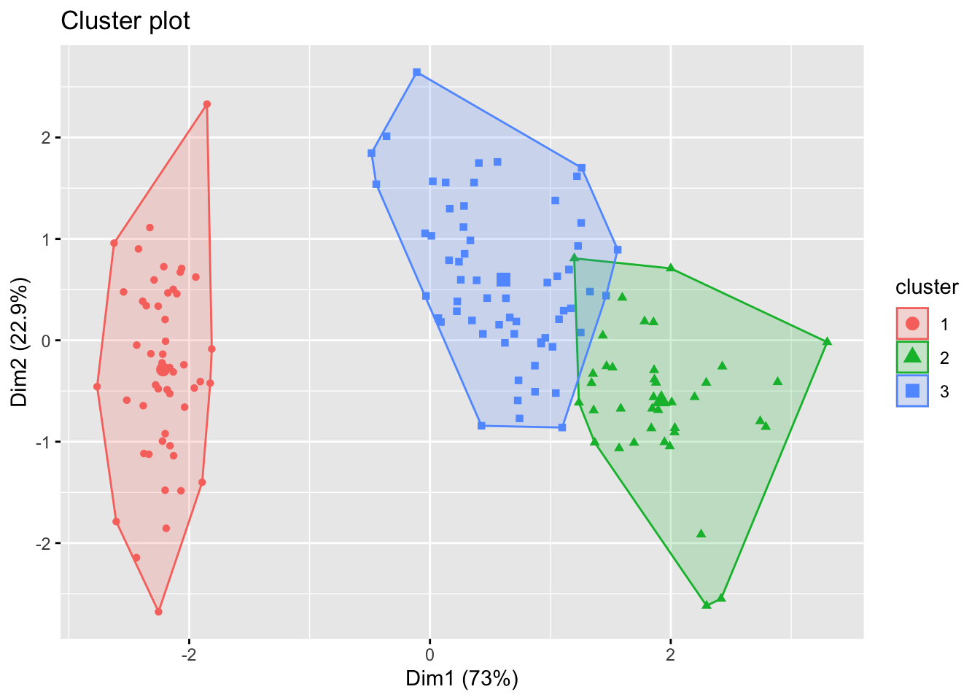

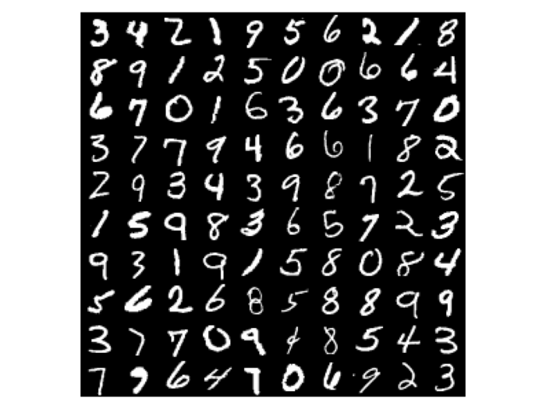
What is multivariate statistics?

Slide 4
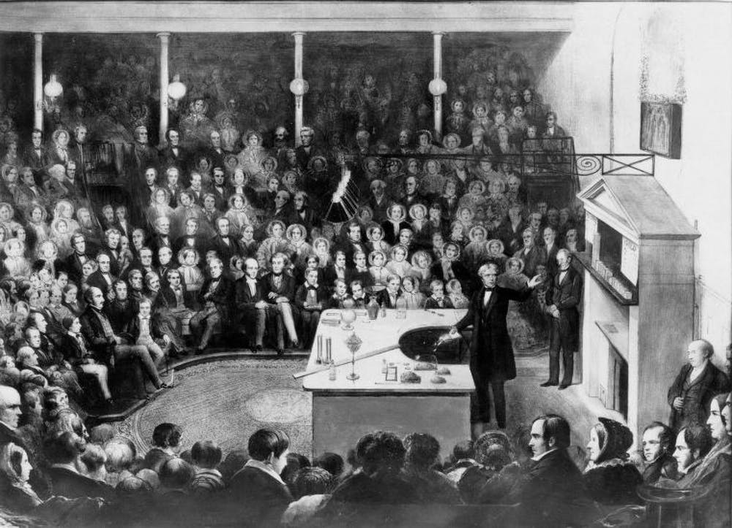
How: flipped learning
Traditional approach to learning is the sage on a stage model: “the professor’s notes get copied to the students’ notes, without passing through the brains of either.”
Classroom time is spent with the student listening to the lecturer, and they are then left to think about and actively engage with the material in their own time.

Slide 5
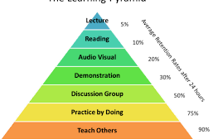
Active vs passive learning
Aim: finish the module understanding the theory, and the practice of multivariate data analysis.
Best way to achieve this is via active engagement with the material.

Slide 6


How: practicalities
Before class:
Read the detailed written lecture notes
Watch the short informative videos
In class:
Discuss, attempt problems, reflect.
Repeat.
After class:
Reflect. If things are unclear – do something about it.

Slide 7
When
Tuesday 11am – 1pm: In person ‘lecture’, Physics B13. I’ll recap the material, and then you’ll attempt questions in groups, and we’ll discuss collectively.
You must have read the notes and watched the videos before the sessions.
Thursday
11-12noon: Computer lab, Coates C19/C20. An opportunity for you to work through the computer exercises, with someone on hand to help if needed.
12-1pm: Online run through the computer exercise solutions (MS Teams). I’ll walk-through the exercise solutions.
Office hours: Tuesdays after the lectures (C19 maths) or Thursdays online office hour (MS Teams). Please come along with any questions you have about the module (or post them on Moodle forum).

Slide 8

Student experience
Pedagogical literature reports the widespread experience that students are more likely to favour a flipped approach once they have experienced flipped learning.
Common fears:
having to "teach oneself”
the unknown
greater amount of academic work

Slide 9
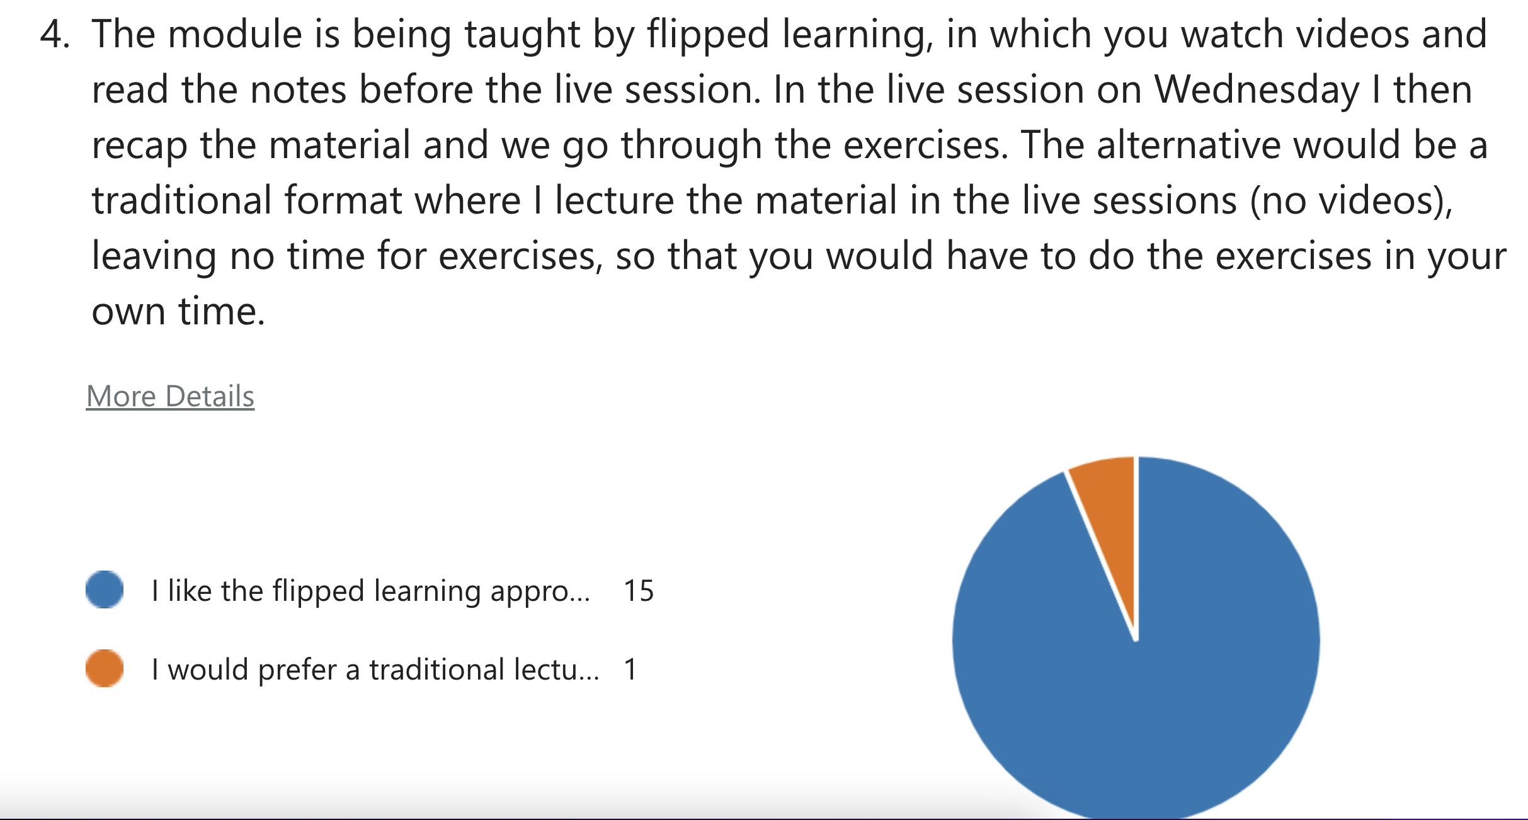
Feedback from previous students

Slide 10
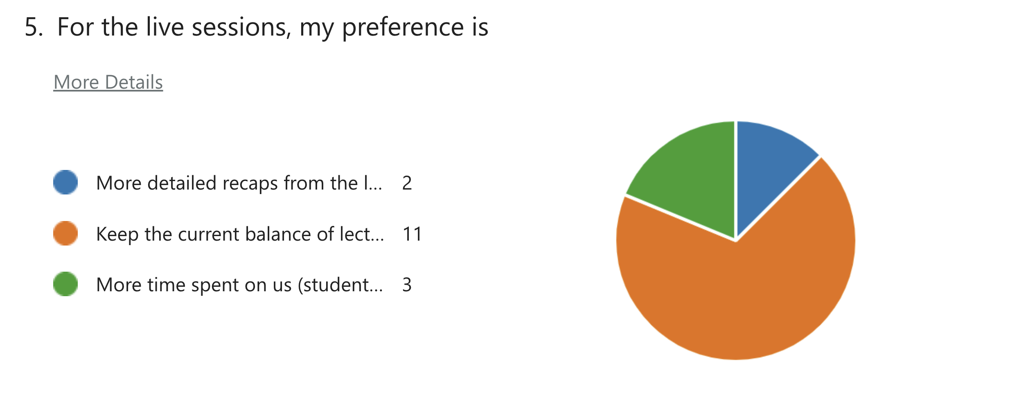
Feedback from previous students

Slide 11
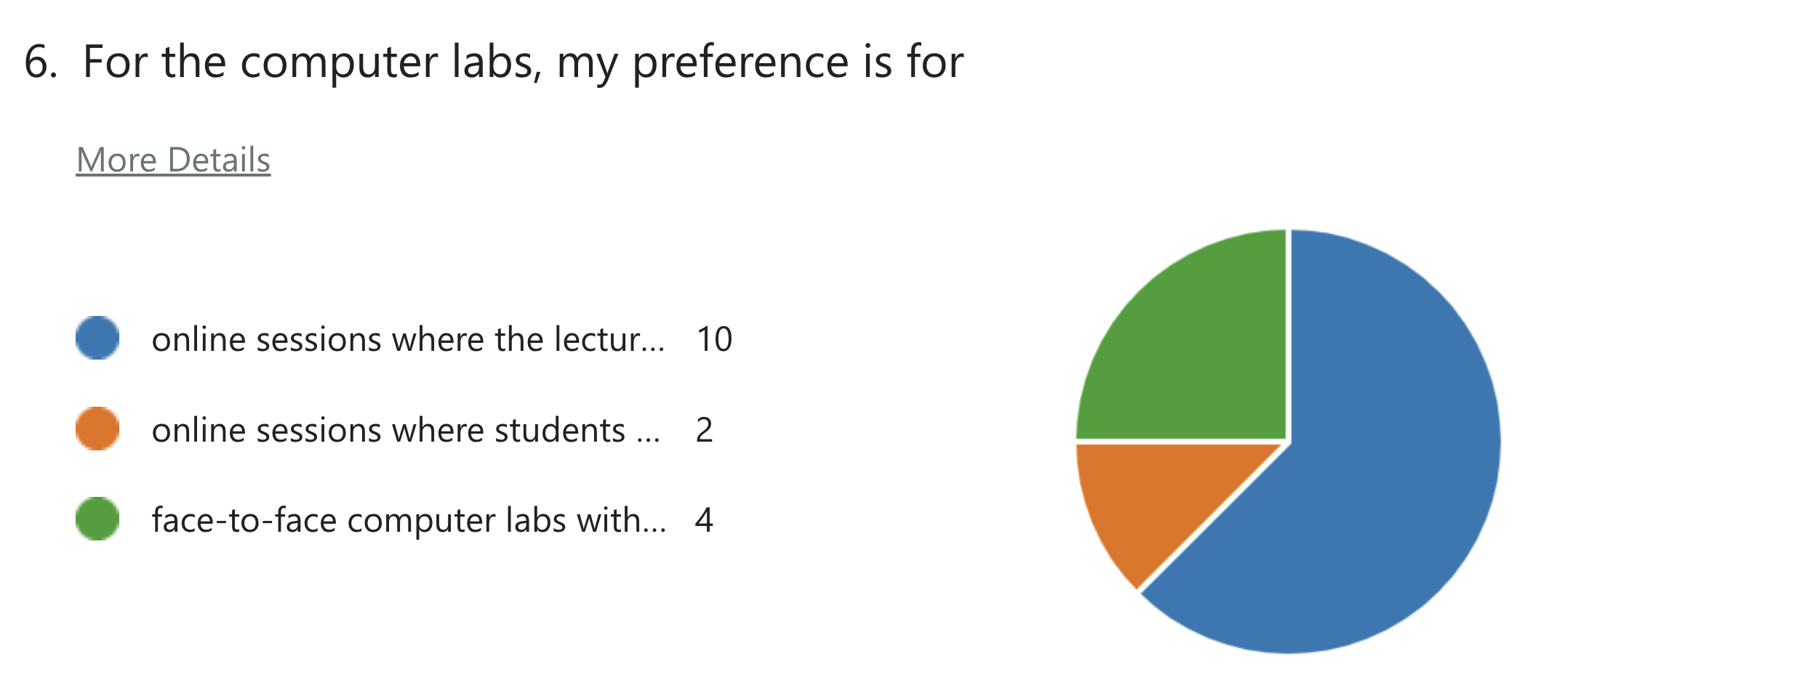
Feedback from previous student

Slide 12
Student feedback:
‘Really like the set up of the in person session’
‘I like the way that I watch videos then and go to lectures. Then, I can focus more on what I don't understand in videos during lecture.’
‘I really like the flipped learning method, we have the chance to schedule our time according to our own pace.’
‘Please spend more time on questions in the Wednesday 2 hour lectures’
‘Provide more exercises, as I don't feel there are enough.’
‘I really like the flipped format, I find it extremely useful for my in depth understanding of the module. I personally think the online labs are very useful too as it’s a lot easier to see what’s happening on screen. The only criticism I have is that I would like the module to have problems sheets. The questions in the notes are useful, but it would be good if the answers were released to this on a separate document the following week. Really enjoying the content!!’
Really like the set up of the in person session.

Slide 13
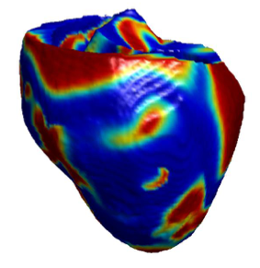
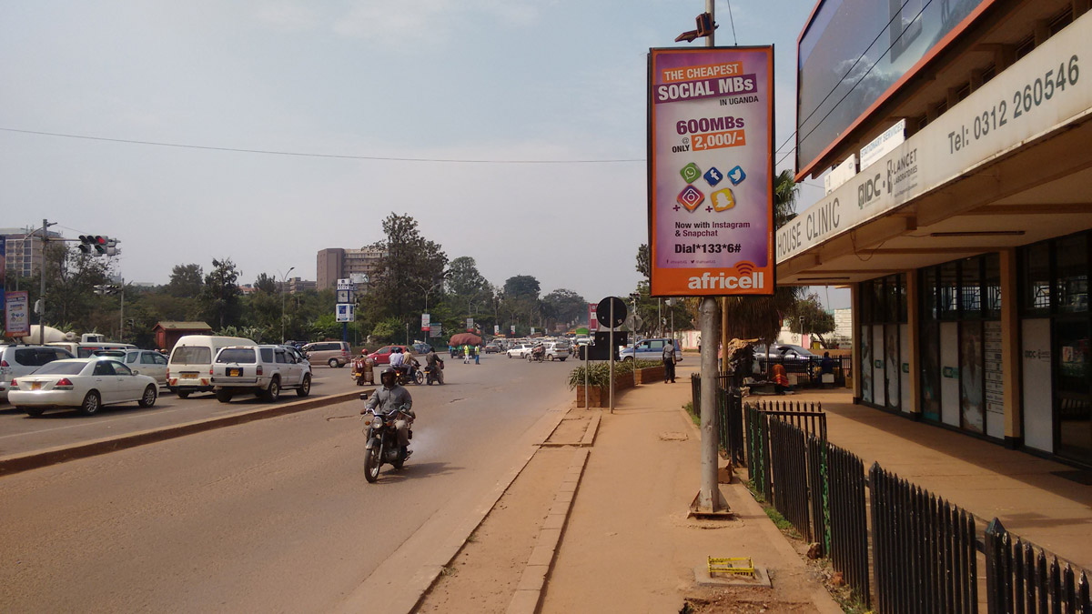

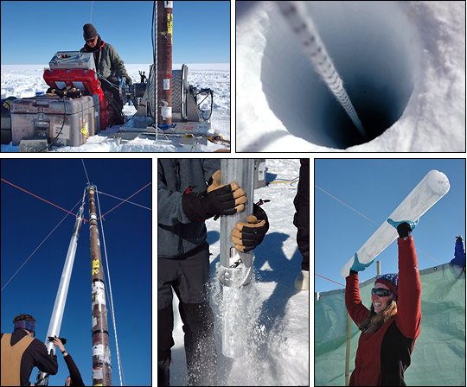
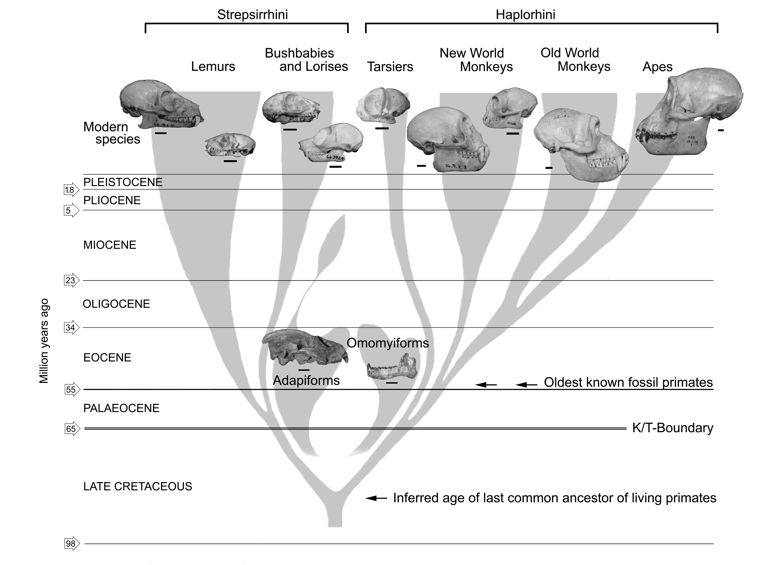
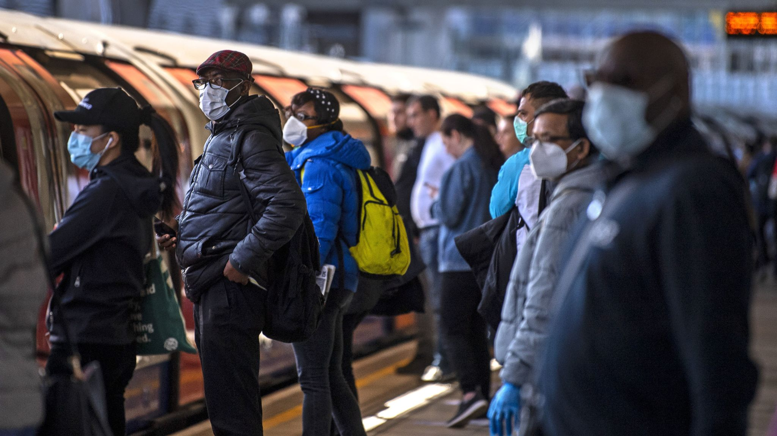

Who:

Slide 14

Assessment
20% coursework. You will have to do some data analysis on a real dataset using the methods from the module.
You will need to be comfortable using R to do well.
CW released on 18 March, deadline will be after Easter vacation.
80% Exam. This will be an in-person exam. Details to be determined.

Slide 15

Resources
The complete lecture notes are online
Don’t be alarmed by the length – its not as bad as it appears
The difficulty is front-loaded. Weeks 1-3 are the hardest.
Each week I’ll write on Moodle which chapter you should read that week
The computer tasks and exercises are in the notes
Moodle forum will be used for discussion of the module content

Slide 16
Module Prerequisites
Module averages: 2022: 70% and 2023: 62% for MATH3030
2022: 52% 2023: 48% for MATH4068 (Top mark 98%).
Nearly all the methods in this module require some linear algebra, which we will focus on for the first two weeks.
I will assume you are familiar with the following:
Matrix and vector manipulation (multiplication, transpose, trace etc)
Eigenvectors and eigenvalues
Eigen-decompositions of matrices
Some basic vector space theory
Some simple calculus
There is a short quiz on Moodle – please try this. If you are unable to answer most of the questions, the module may be the wrong choice for you.

Slide 17


How to contact me
Moodle Forum/Discussion board
Questions about the module content
Email
personal things only relevant to you.
MS Teams
Only for asking questions during live online sessions please!

Slide 18
Key points:
Watch the videos and read the notes for that week before the live Tuesday session.
Come prepared to discuss and engage with the material!
Thursday 11-12midday computer lab. Work through the exercises.
Bring your questions to the Tuesday session, or office hour, or post on Moodle discussion board.

